Slide 1

AIRBNB HOTEL BOOKING ANALYSIS
Krishna Gelra
APPLY_175556150468a3be2048388

Slide 2

PROBLEM STATEMENT
Property owners frequently utilize Airbnb to rent out their homes or apartments to travelers. However, the most challenging aspect for these hosts is establishing an appropriate rental price. This price is not fixed; rather, it fluctuates based on numerous factors like the number of bedrooms and bathrooms, the property's cleanliness, the accuracy of the listing's descriptions, and the quality of communication between host and guest.

Slide 3
PROJECT DESCRIPTION
This project aims to develop a robust machine learning regression model designed to accurately forecast the price of Airbnb listings. Optimal pricing is essential for both market participants: hosts seek to maximize both their earnings and property occupancy, while guests demand competitive and fair rental rates. By analyzing historical Airbnb transaction data, the model will establish and utilize the correlations between specific property characteristics—such as the count of bedrooms, number of bathrooms, and overall guest ratings—and the observed price fluctuations.

Slide 4

WHO ARE THE END USERS?
Airbnb Hosts: To analyze pricings of their listings based on various property features and guest reviews.
Travellers: To evaluate whether a listing is overpriced or reasonably priced.
Airbnb Platform Analysts: To improve the automated pricing suggestions on the platform.
Researchers/Students: To study the impact of property features and reviews on the rental prices.

Slide 5

TECHNOLOGY USED
Python: used as the primary programming language
Pandas & Numpy: used for data cleaning and preprocessing
Scikit-learn: used for machine learning (model training, evaluation, etc.)
Matplotlib & Seaborn: used of data visualization and feature importance
Google Colab: used as the primary IDE for creating and running the project

Slide 6
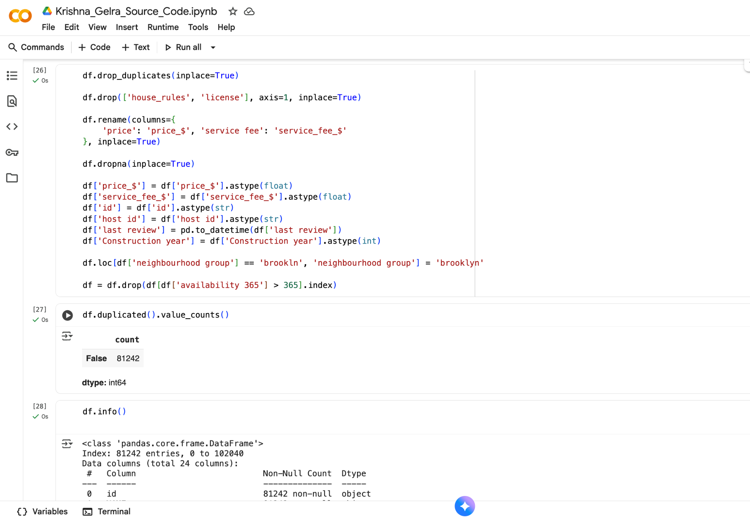
RESULTS 1
Github Repo

Slide 7
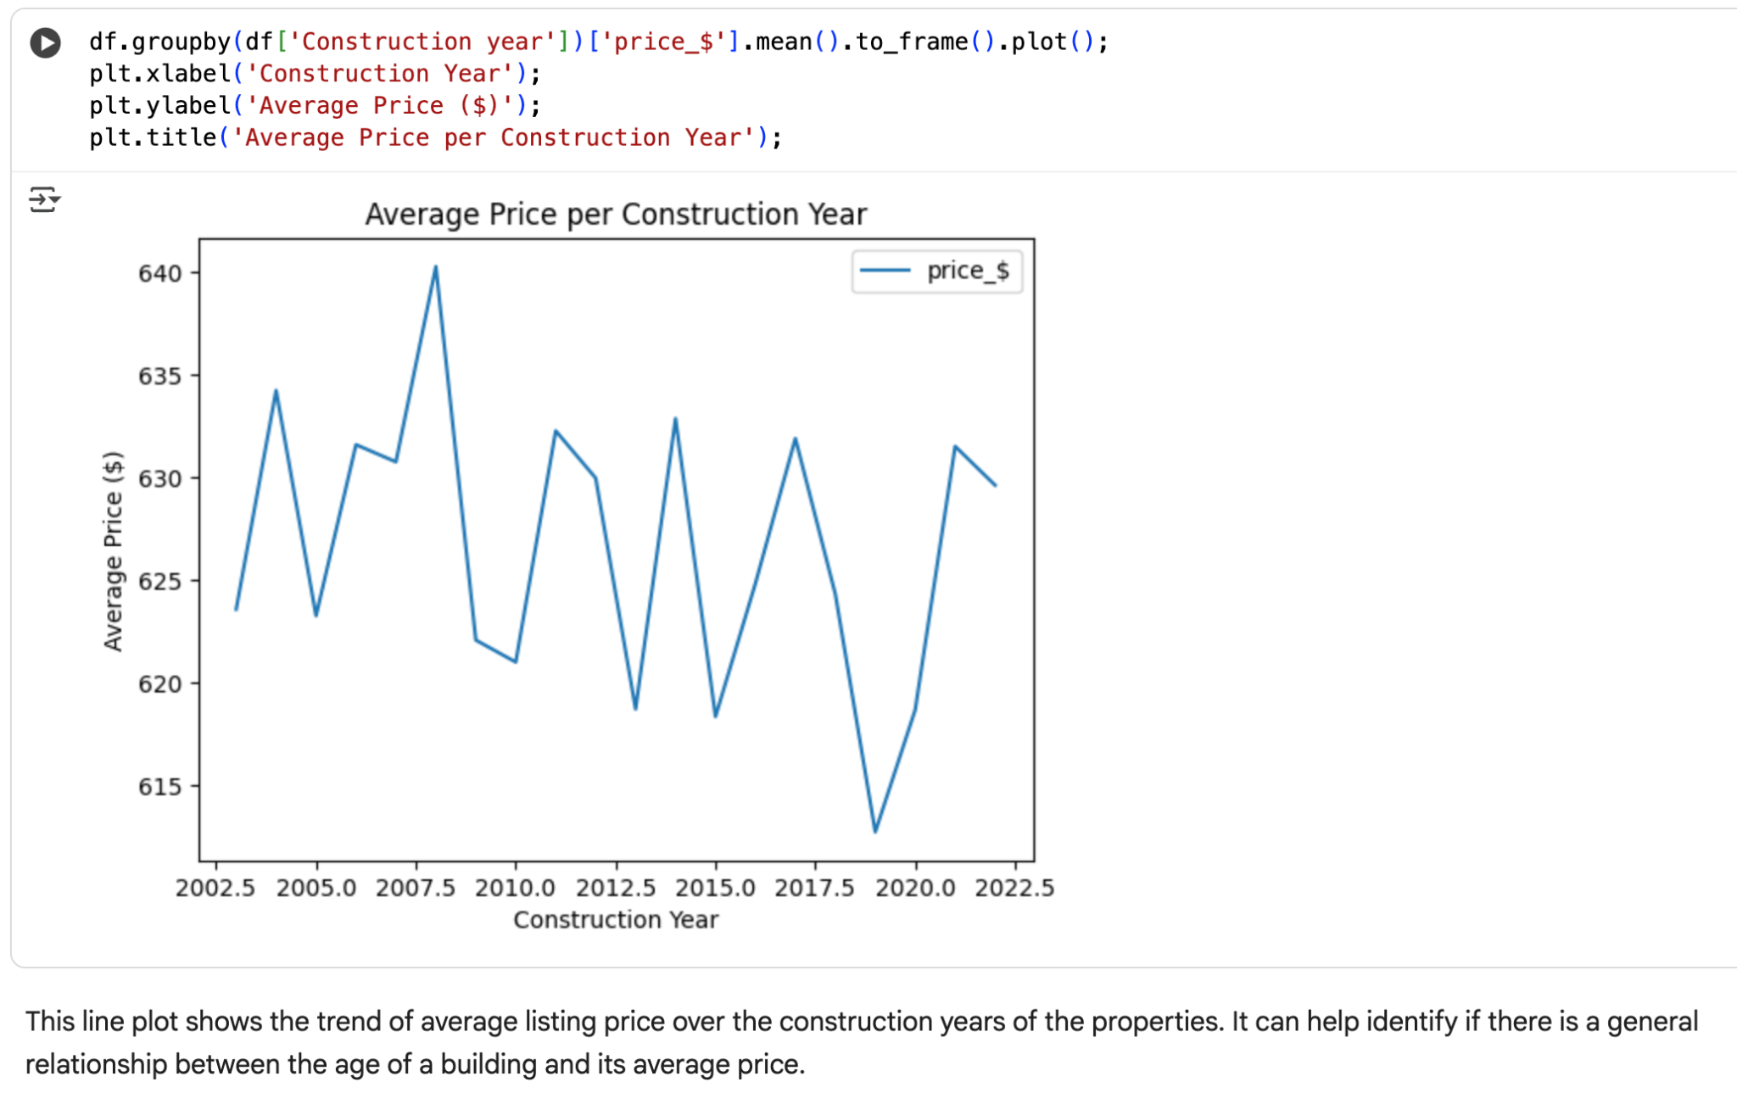
RESULTS 2
Github Repo

Slide 8
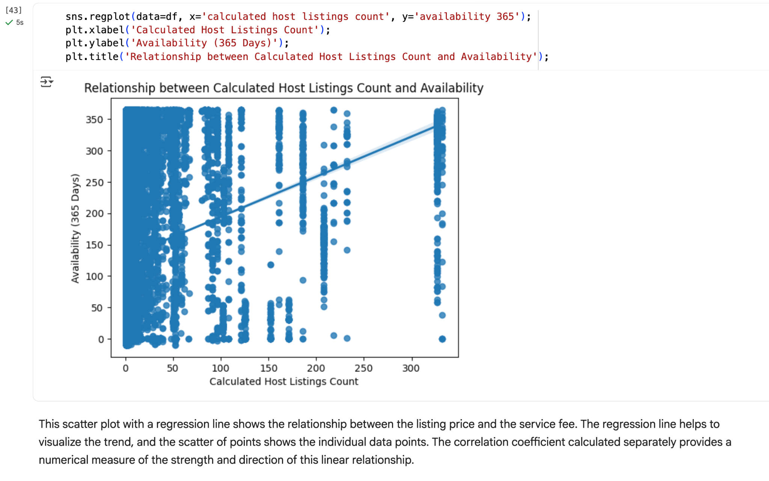
RESULTS 3
Github Repo

Slide 9
GitHub repository
Github Repo Link:
https://github.com/KrishnaG-101/VOIS_AICTE_Oct2025_KrishnaGelra/tree/main

Slide 10
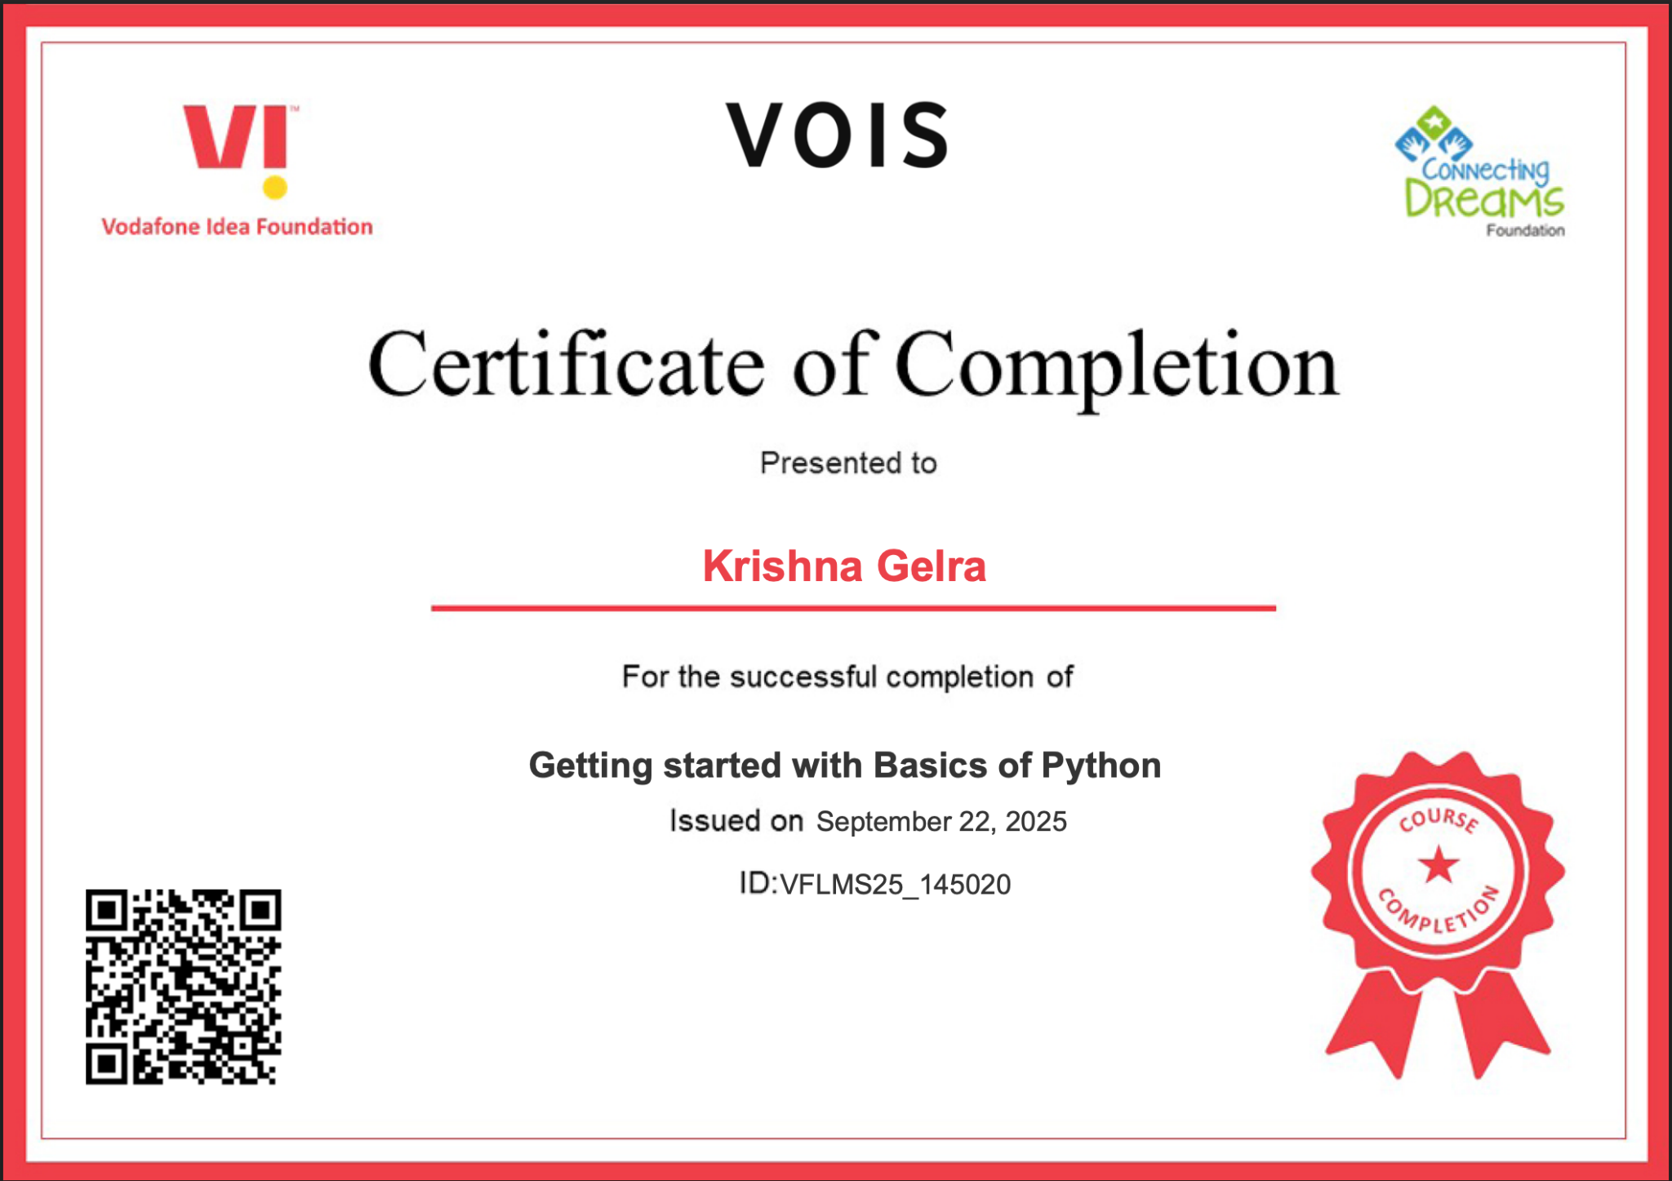
Getting started with Basics of Python Certificate

Slide 11
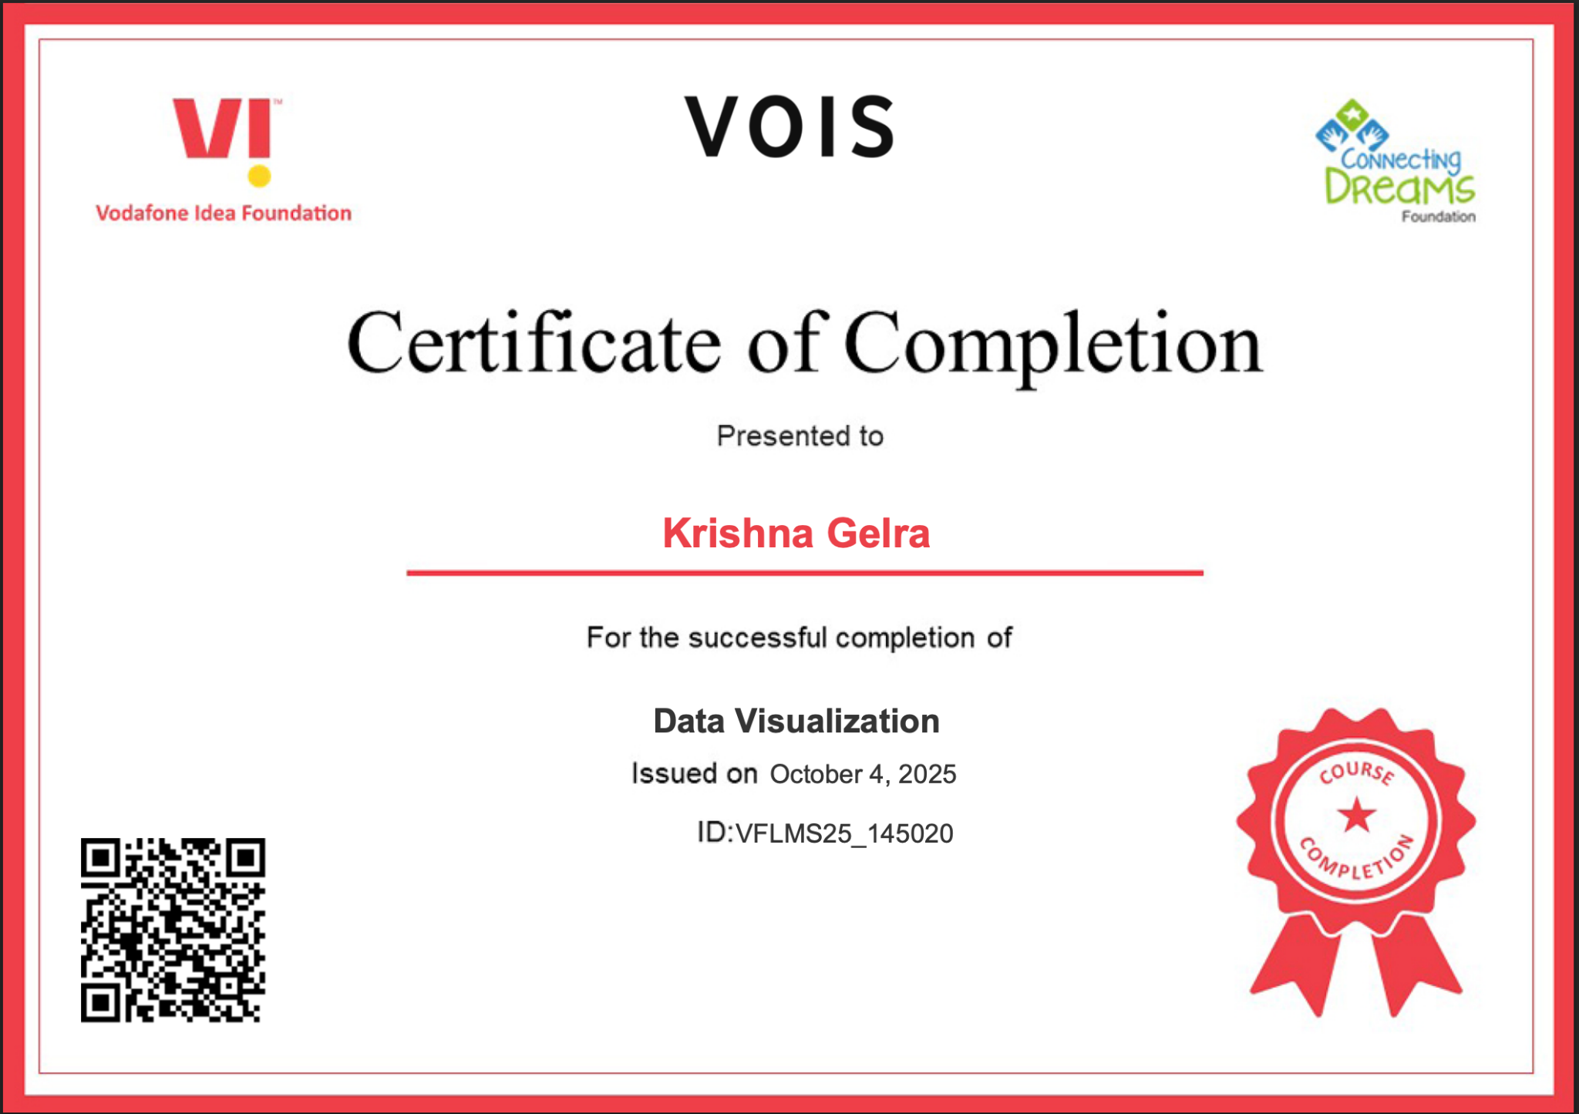
Data Visualization Certificate

Slide 12
Thank you

